Slide 2
Full Stack XP
The Game Show!!!!

Slide 3
Full Stack XP
Game show!!!!

Slide 4
The rules
Everyone in the room is a contestant. Congrats!
Form groups and get to know each other.
Tactically, to win the game you'll want a cross functional group: knowledge of front end, middle, and back end.
If you're in a bad group then act fast! Run!
The game show host will be final arbiter in cases of a tie.
Good Luck!!! Some of you are going to need it!

Slide 5
Answer the following
True/False
Blue is the best color
Which of the following is the best number:
42,
-5, or
6i^2.
Practice question

Slide 6
Full Stack
TDD
System Testing
Emergent design
Shared code ownership
Pair Programming
Simple Design
System Metaphor
Sustainable Pace
Planning Game
Continuous Integration
…
Image source:

Slide 7
What's the easiest tier to do XP in:
Front,
Middle, or
Back?

Slide 8
Middle tier
The "easy tier."

Slide 9
Middle tier
@GET
@Path("squirrels/{id}")
@Produces("application/json")
public Squirrel getSquirrel(@PathParam("id") String id) {
Squirrel aSquirrel;
try {
aSquirrel = thePark.getSquirrel(id);
if (aSquirrel == null)
throw new SquirrelGoneMissingException(“No squirrel: “ + id);
} catch (Exception e) {
throw new ServiceException();
}
return aSquirrel;
}
App server, a VM runtime environment, SOA.
True or false:
Test First can be done to drive this all this code?
What line of code must be system tested rather than unit tested?
How many unit tests are needed to cover this code?

Slide 10
Which of the following is allowed in a unit test:
Deadly Unit test sins
Network access,
File access,
hardware clock, or
DB access.
Is using an in-memory DB a suitable unit test strategy?

Slide 11
answer the following
Spring and TDD
Using Spring for dependency injection requires the use of what configuration file?
For writing system tests, is it an acceptable strategy to require this file?
For writing unit tests, is it an acceptable strategy to require this file?
What's an alternative strategy for unit testing code that uses Spring?

Slide 12
Back end
The "develop docs before the code" tier.

Slide 13
Which of the following describes emergent design:
Defining schema a year in advance;
Defining schema a month in advance;
Defining schema a sprint in advance;
Defining schema during the sprint; or
All of the above.

Slide 14
Which of the following supports emergent design:
Source control,
Migration scripts,
TDD, or
All of the above?

Slide 15
Which of the following is a suitable Unit Test strategy for stored procedures:
Tests written in C# and Nunit going over a data connection targeting a stored procedure;
Tests written in a stored procedure language targeting a stored procedure;
Tests written in C# and Selenium driving a web app, targeting a stored procedure; or
You can't unit test the database so forget about it?
CREATE OR REPLACE PROCEDURE truncit (
tab IN VARCHAR2,
sch IN VARCHAR2 := NULL
)
IS
BEGIN
EXECUTE IMMEDIATE 'truncate table ' || NVL (sch, USER) || '.' || tab;
END;

Slide 16
answer the following
Data setup and TDD
Stored procedures typically are dependent on?
For writing system tests, is it an acceptable strategy to require many tables and rows of data?
For writing unit tests, is it an acceptable strategy to require many tables and rows of data?
What's an alternative strategy for unit testing code in a stored procedure?

Slide 17
Front end
The "our code is too simple to unit test" tier.

Slide 18
can be unit tested
Layout looks correct. (True/False)
Spelling of text is correct.
Form validation works.
Colors aren't clashing.
The page contains all the widgets.
Activating widgets causes reaction.

Slide 19
Fast feedback
var renderAllPurchases = function(purchases) {
var purchasesMap = {};
var allPurchasesList = $('ul.purchases-tile-list.all');
var deferred = $.Deferred();
shopDust.render('ui-purchases-tiles-template', { purchases: purchases, includeIds: true }, bundle).done(function(out) {
$(allPurchasesList).empty().append(out).shopPaymentsTileList();
// Create a map of the purchases (indexed by cust id)
$.each(purchases, function(index, cust) {purchasesMap[cust.id] = cust;});
// attach the purchases map to the document
$(document).data('purchasesMap', purchasesMap);
// toggle classes based on list contents
setListClasses(allPurchasesList);
deferred.resolve();
});
return deferred;
};
True or false:
Test First can be done to drive this all this code.
What line of code must be system tested rather than unit tested?
How many unit tests are needed to cover this code?
What can refactoring would enable more unit tests?

Slide 20
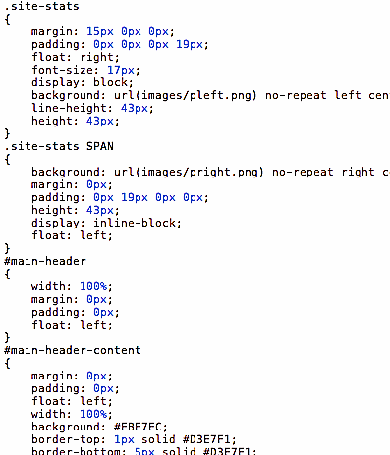
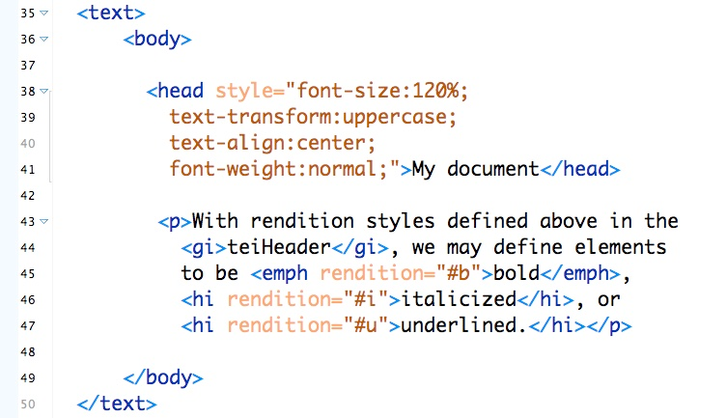
How many unit tests?
To test drive changing a CSS class, how many unit tests?
To test drive changing HTML, how many unit tests?

Slide 21

answer the following
Unit testing DOM
Manipulation
JavaScript functions that directly manipulate the DOM often rely on preconditions stored in what file(s)?
For writing system tests, is it an acceptable strategy to require these file(s)?
For writing unit tests, is it an acceptable strategy to require these files? (Jasmine Fixture files)
What's an alternative strategy for unit testing code such code?

Slide 22

Big picture

Slide 23
Which is hardest to unit test?
Front end
Back end
Middle
Mobile
Embedded controller
HTML/CSS
Configuration files

Slide 24

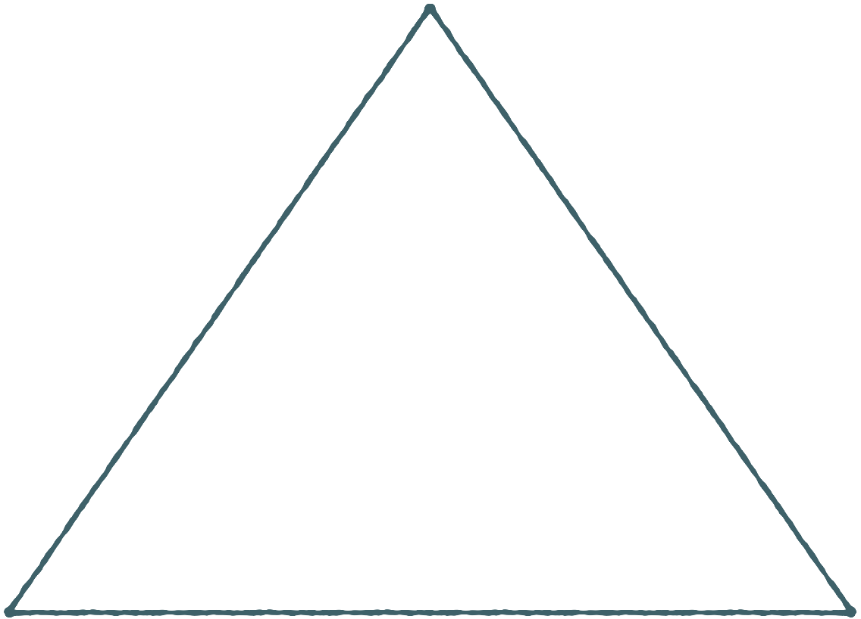


Which test strategy provides What Benefit
system test or Unit test
Manual
& GUI Tests
Makes refactoring easy
Indicates there is a regression
Indicates approximate location of the code causing a regression
Confirms the app still works
Confirms the code works as the developer intended
Confirms the app works as the customer has specified
Confirms scalability, security, and performance.
Gives feedback in seconds to minutes.
Gives feedback in hours to days.
System Tests
Unit Tests

Slide 25
Good way to differentiate system from unit test (T/F):
Test Inventory Organization
Manual
& GUI Tests
Don’t bother so it takes 20 minutes+ to run unit tests.
Using maven with the appropriate life-cycle (test and integration-test).
Run unit or system tests within Eclipse but it takes 5+ clicks.
Use JUnit test suites, one for Unit Tests, the other for System Tests.
Separate directory for unit test and separate for system tests, then use run-as->Junit Test
Mingle unit tests with product code. System Tests in another project.
System Tests
Unit Tests

Slide 26

Which of the following people are proficient at TDD?
I’ve written 50 unit tests in the past 4 weeks.
I’ve written thousands of unit tests in my ten year career.
I do TDD the it’s policy.
Yesterday I went to work and didn’t write a unit test.
From left to right, person 1, 2, 3, or 4.

Slide 27
Takeaways
Cleanup test inventories
Test drive all your OO, DB procedures, and functional language code. (90-99% of your code)
System Test what you can’t unit test (10%)
Unit test your full stack: (tools I prefer) NUnit, JUnit, UTPlSql, T.S.T.Sql, (test in a Nodejs environment with—Karma + Chai or Jasmine)
System Test what’s left: Selenium, BDD framework,
Automate your DB migration: FlywayDB
Refer to: ConfessionsOfAnAgileCoach.blogspot.com

Slide 28
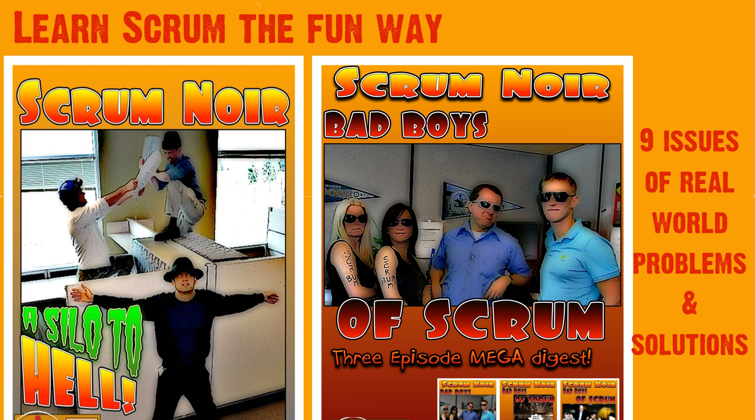

Hope you enjoyed and won A SCRUM COMIC, AGILE NOVEL, OR …!

